Slide 1
Natural Language Processing
AI4ALL Princeton 2018

Slide 2
Before we start
Notes:
Ask about any questions from the. Morning session and note them down!

Slide 3
What is “NLP”?
“Natural-language processing (NLP) is an area of computer science and artificial intelligence concerned with the interactions between computers and human (natural) languages, in particular how to program computers to fruitfully process large amounts of natural language data.”
- Wikipedia
https://en.wikipedia.org/wiki/Natural-language_processing

Slide 4
Why is NLP important?
Why am I here?

Slide 5
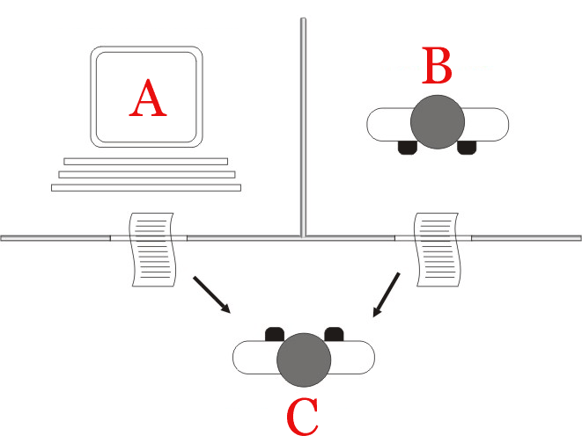
The Turing Test
https://en.wikipedia.org/wiki/Alan_Turing#/media/File:Alan_Turing_Aged_16.jpg
https://en.wikipedia.org/wiki/Turing_test#/media/File:Turing_test_diagram.png

Slide 6
“Analysts at Gartner (gated) estimate that upward of 80% of enterprise data today is unstructured.”
https://www.forbes.com/sites/forbestechcouncil/2017/06/05/the-big-unstructured-data-problem/#13919ec4493a

Slide 7
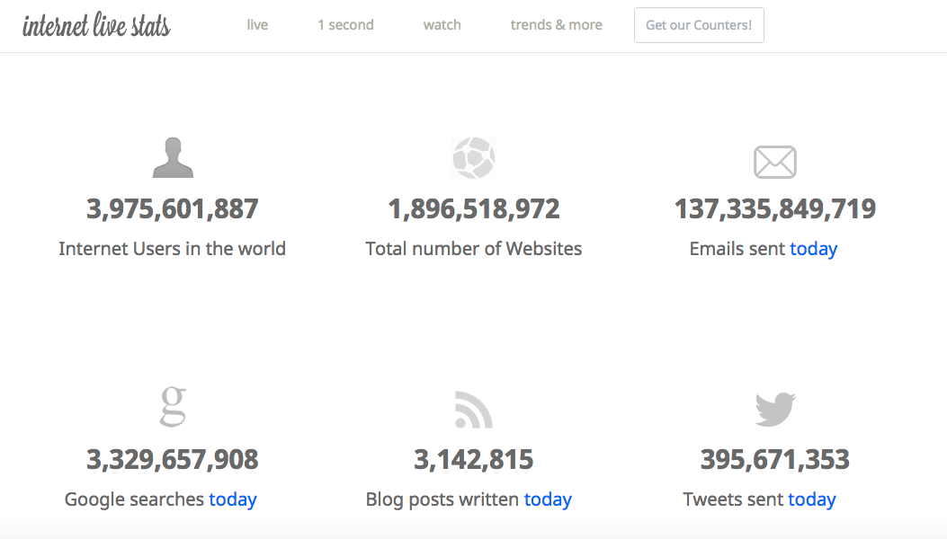
http://www.internetlivestats.com/

Slide 8
What can computers do?
Why is it different from what we can do?

Slide 9
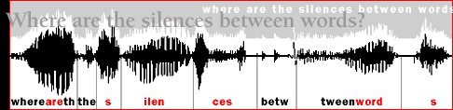
Human Learning
Humans are very, very good at language
Statistical learning: learning how to understand and speak language by analyzing how others speak
Word frequencies, word order, recurring grammatical patterns
Segmentation: 8-month-old infants react differently to pseudowords than non-words after 2 minutes of exposure to nonsense speech
Examples:
“Powerful coffee”
“Strong rain”
“Profound sleep”
http://akenney.github.io/mind-cascade/language/

Slide 10
Computer learning
Speech recognition
Sentence segmentation
Phoneme labeling
Natural language understanding
Topic segmentation
Sentiment analysis
Summarization
Information extraction
Prediction
Natural language generation
Writing rhyming poetry
Writing thematic stories
Writing news articles / research articles from data

Slide 11
Natural Language Understanding
Speech Recognition
Natural Language Generation
Check the internet for response to question (or perform an action)
Form sentence around answer information using grammatical rules
Use speech to text!
Label parts of sentence
Identify key words and relationships in request
Extract a search query or an action command
Break speech down into letter / sound chunks
Compare to recorded phonemes and pick likeliest combinations

Slide 12
Why is that so hard?
Talking is easy!

Slide 13
http://what-when-how.com/how-to-build-a-digital-library/word-segmentation-and-sorting-digital-library/
Notes:
Segmentation

Slide 14
https://www.ecenglish.com/en/social/blog/ec-central/2015/11/23/vocab-review-homophones
https://www.creators.com/read/speed-bump/02/16/165650

Slide 15

http://onthesannyside.blogspot.com/2015/08/fun-with-dangling-modifiers.html

Slide 16
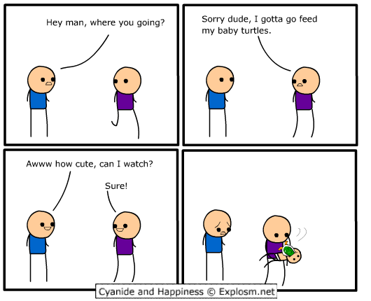
http://explosm.net/comics/1206

Slide 17
How can NLP help?
How has it been used?

Slide 18
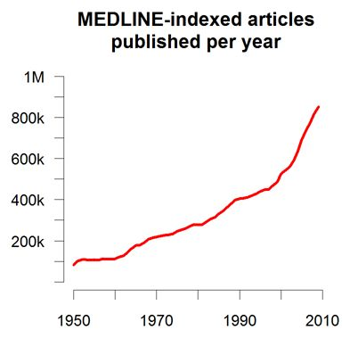
Medicine
Clinical decision support
Process narrative text in electronic healthcare records to help doctors make clinical decisions
IBM Watson can learn from entirety of Medline literature; impossible for doctors to read even a fraction of this
Note-taking
Allow doctors to dictate their notes
Tag these notes appropriately

Slide 19
Law
Help lawyers retrieve relevant documents and legal cases for the case they’re working on
Create summary reports of long legal briefs or contracts for lawyers and clients
Detect convictions that can be downgraded and fill out the relevant paperwork!

Slide 20
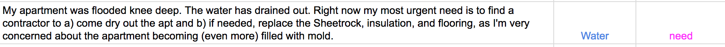
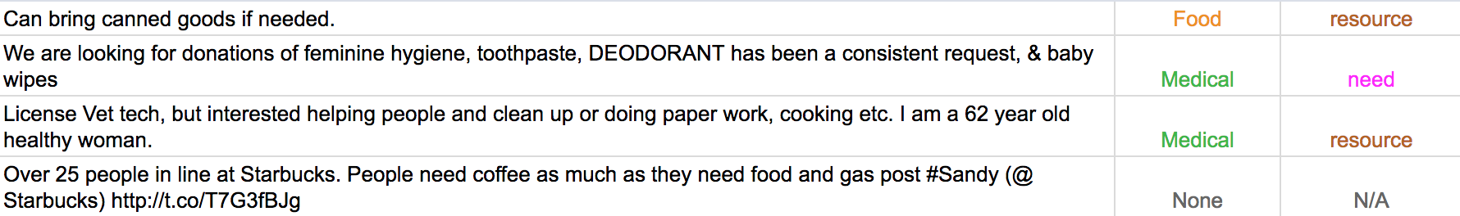

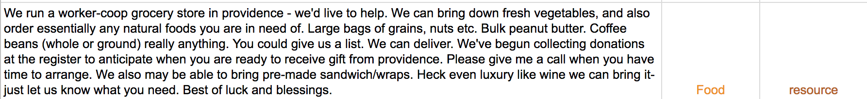
Disaster Relief (Twitter)

Slide 21
How does NLP work?

